Slide 1
Youscience
6th Grade Interest Profiler
Login to Infinite Campus

Slide 2
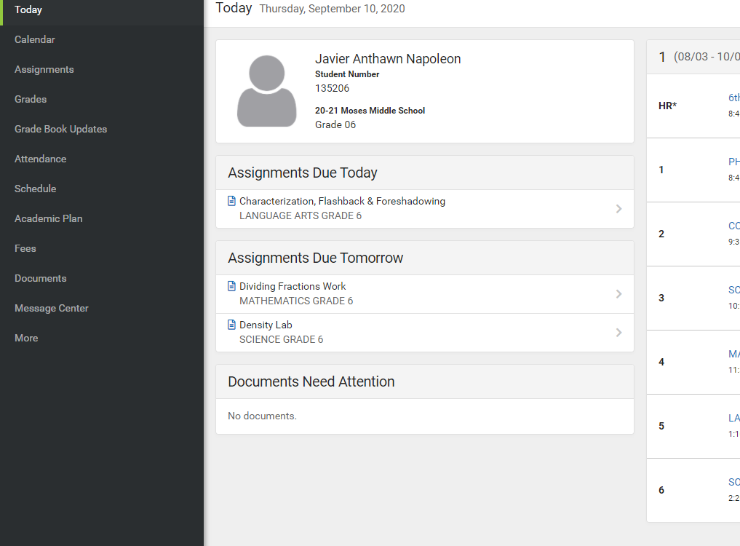
Login to Parent Portal/Infinite Campus
On the left hand side click “more”

Slide 3
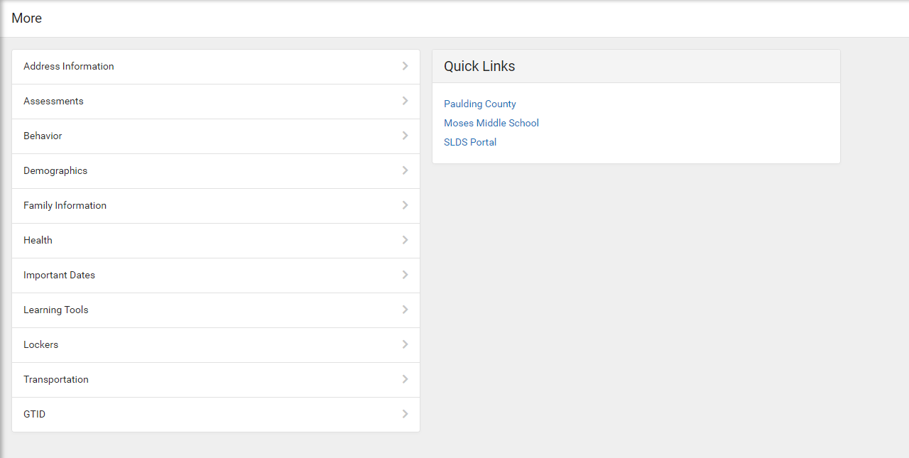
On the right side under our school name click “SLDS portal”

Slide 4
When you get in SLDS, choose “My Career Plan”

Slide 5
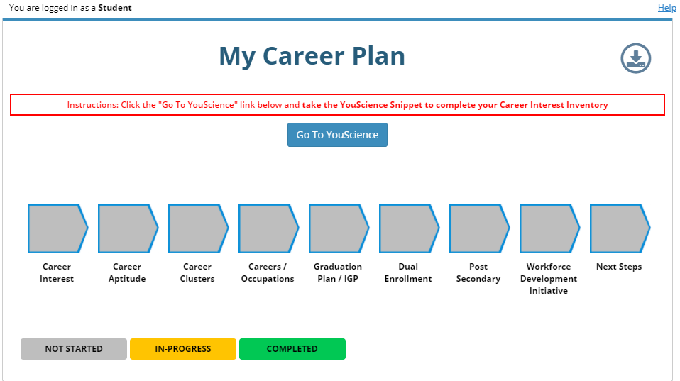
Choose “Go To Youscience”

Slide 6
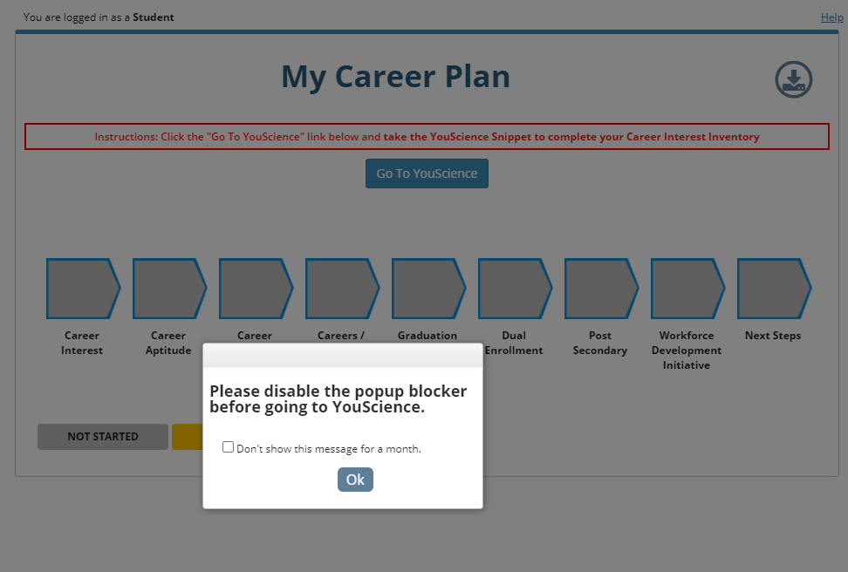
A popup blocker will appear, click “OK”

Slide 7
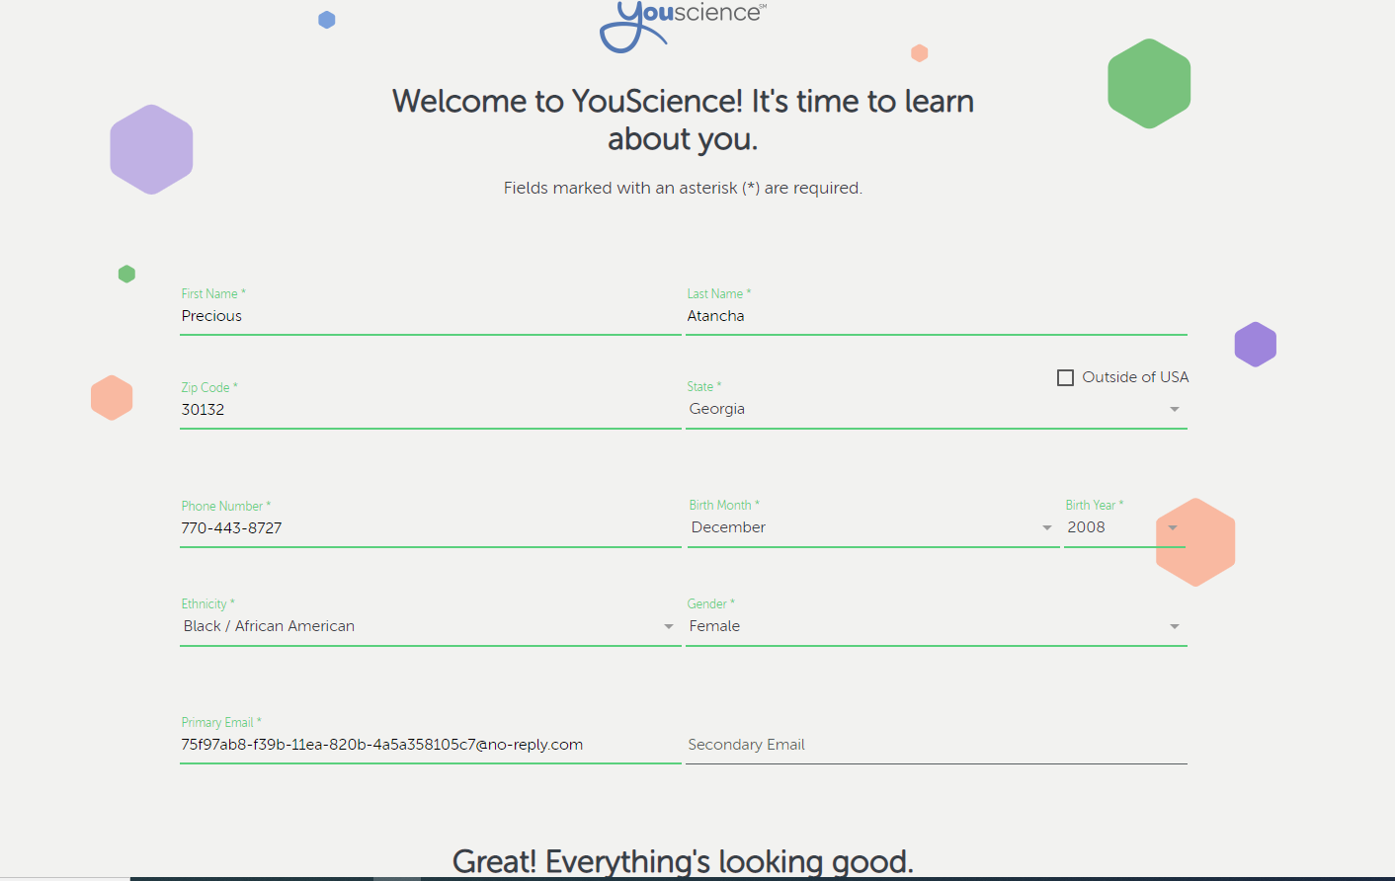
Enter information below. Use School Phone number. Primary email will be automatic.
Scroll down and click “Ok, Let’s Get Started”

Slide 8
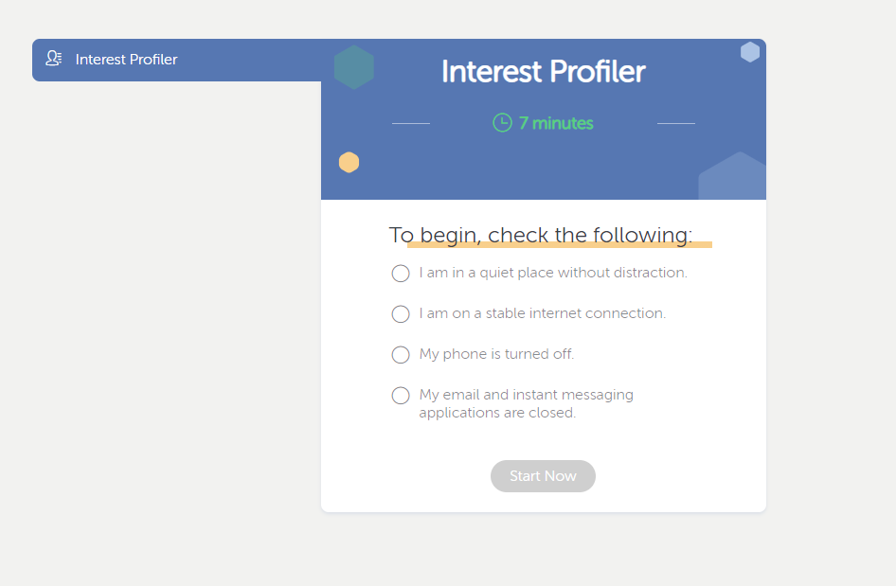
Click each circle. After you have clicked each “Start Now” will change colors. Click “start now”.

